Slide 1

Expanding influence
Home Masters
Notes:
Relevance of print media in the Digital age

Slide 2

The Problem
Urban consumers face discomfort of Air conditioners due to Installation Problems, limited portability and high power usage, necessitating an advanced, compact, and feature-rich portable AC solution to meet their needs effectively.

Slide 3

Our Solution
Our product is a portable AC, designed for ambient room temperature regulation to ensure comfortable living conditions. This is an advanced home appliance that combines efficiency, technological sophistication, premium and minimalist design to cater to the modern consumer's needs.

Slide 4




The Home Masters Advantages
Smart, Connected & Energy efficient
Cooling Technology (Twin Cool Inverter, jet stream)
Copper Condenser, Facia – Premium tech based design
Voice command enabled through wi-fi
Energy Efficiency (Inverter, high ISEER rating)
Fastest emerging AC brand in Delhi NCR
Clean Air nano- Claim- 99.9% removal of bacteria and PM2.5.
App enabled control
Lineage of Tech Enthusiast

Slide 5

Target Segment Analysis
Demographics
Our target customers are primarily aged between 18-40 years with high disposable incomes, residing in metro and mini-metro cities. They have the financial ability to invest in premium home appliances.
Psychographics
The target customers are actively engaged in social media, own the latest technology gadgets, and are environmentally conscious. Their limited living space calls for products that offer comfort and convenience without compromising on style.
Location
They are concentrated in urban areas where modern lifestyle and compact living quarters necessitate efficient and space-saving home appliances.
Notes:
Home MastersAC’s has gained 1.4% market share during last season, however we want to be among the top 5 AC brands in India, targeting >10% market share this season

Slide 6

With much to do and get done, Automation adds to their life

Slide 7
Reason for Choosing Target Segment
Preference for Comfort and Functionality
Disposable Income and Tech Savvy
Engagement with Technology
Their lifestyle choices indicate a preference for products that offer both functionality and style, aligning with the value proposition of our portable AC unit.
The chosen segment's high income and tech-savvy nature make them inclined towards investing in advanced, technology-driven products that complement their modern lifestyle.
Their active engagement with the latest technology implies a greater appreciation for the advanced features and functionality of our portable AC, including smart capabilities and energy efficiency.

Slide 8
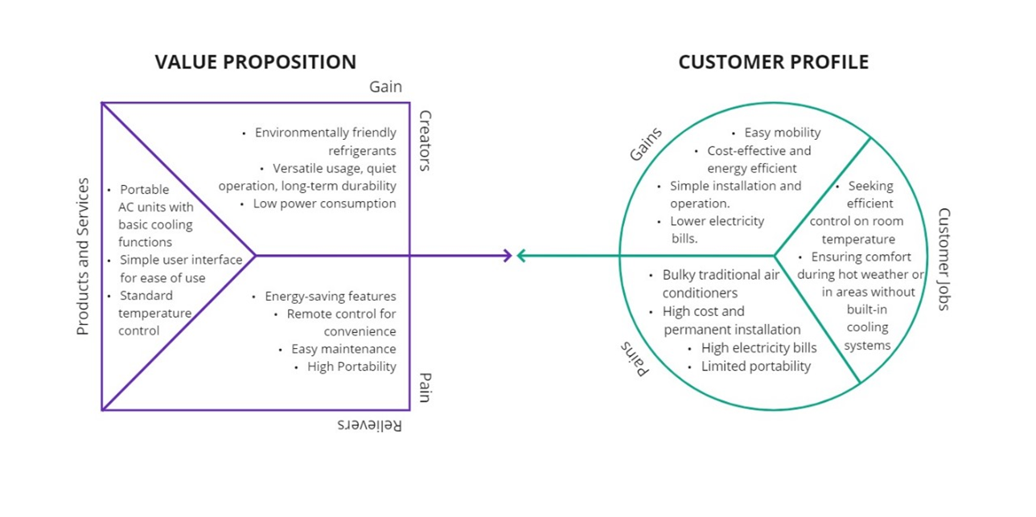
Value Proposition Canvas

Slide 9
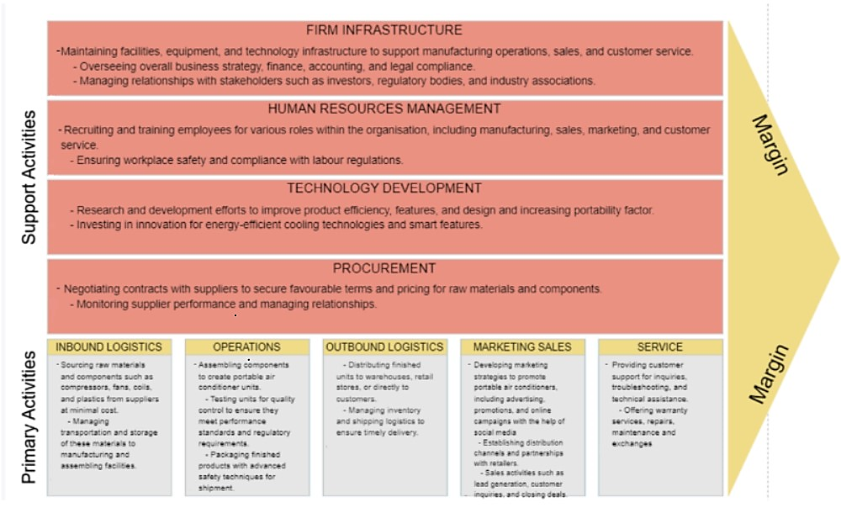
Value Chain MODEL

Slide 10
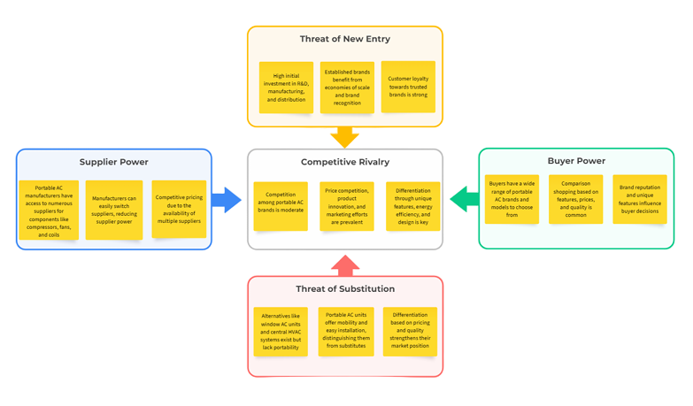
Porter’s Five Forces Model
Notes:
Clear positioning of New age AC with complete peace of mind utilizing connected tech
Lift brand imagery
Build a category association between Home Masters& Air conditioners category
Create a clear cut / differentiated positioning

Slide 11

The business objective
Share of 10 % or more in the targeted markets by end of year 1
To be amongst top 10 AC brands in Delhi NCR by end of year 3
To be recognised as most technological advanced environment friendly AC
Notes:
Home MastersAC’s has gained 1.4% market share during last season, however we want to be among the top 5 AC brands in India, targeting >10% market share this season

Slide 12

MARKETING objective
Short-term Goals (Next 6 months):
Increase customer inquiries by 30% through enhanced digital marketing efforts.
Develop partnerships with real estate firms to secure HVAC installation contracts for new homes and commercial buildings.
Long-term Goals (Next 1-2 years):
Establish Home Masters AC as a leading brand in sustainable and energy-efficient AC solutions.
Expand service offerings to include annual maintenance contracts and premium services.
Notes:
Clear positioning of New age AC with complete peace of mind utilizing connected tech
Lift brand imagery
Build a category association between Home Masters& Air conditioners category
Create a clear cut / differentiated positioning

Slide 13


The business challenge
Consumers are on familiar terms with competition when it comes to ACs but they don’t think about us.
Home Masters has not been able to build positioning/product differentiation as yet
Unaided awareness is low for Home Masters in AC category.
We do not feature among top 5 brands in this category

Slide 14
Communication objective
Create a meaningful connection between ACs and Home Masters in the consumers mind as the deliverer of complete peace of mind via connected tech
Build a category association between Home Masters& Air conditioners category
Create a clear cut / differentiated positioning

Slide 15
UNDERSTANDING OUR AUDIENCE

Slide 16

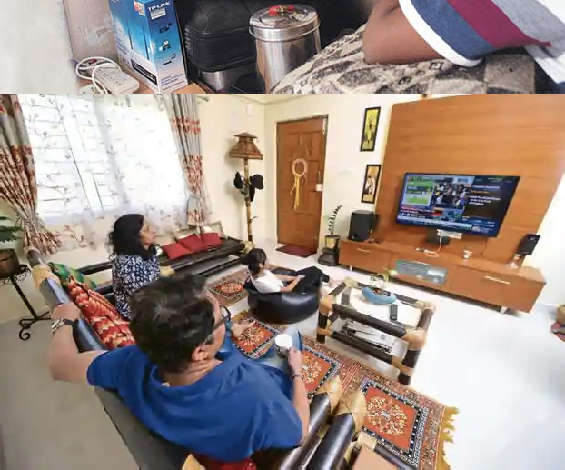



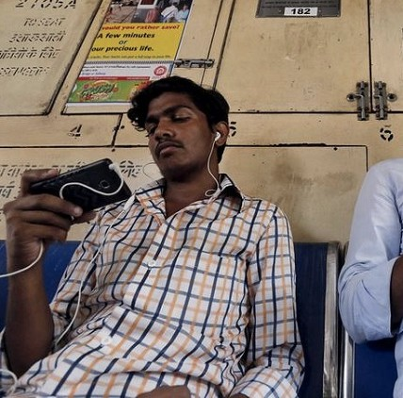
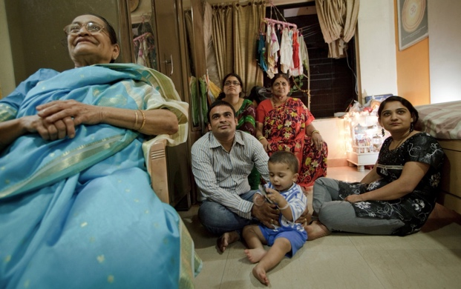
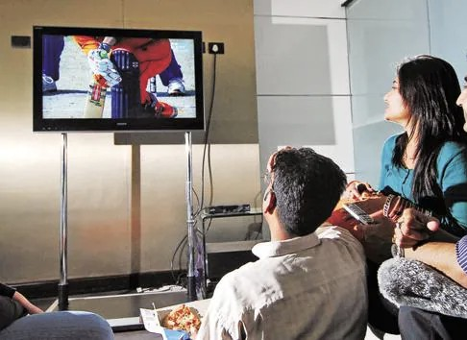


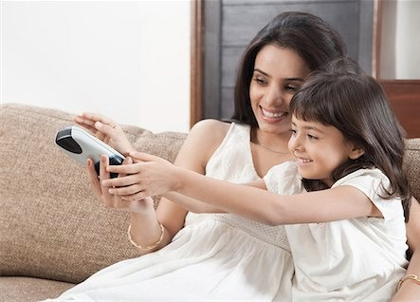
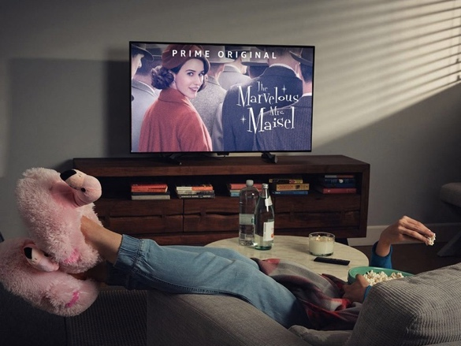
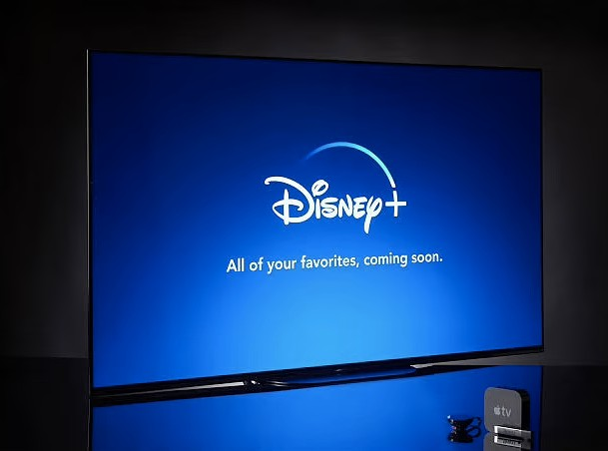

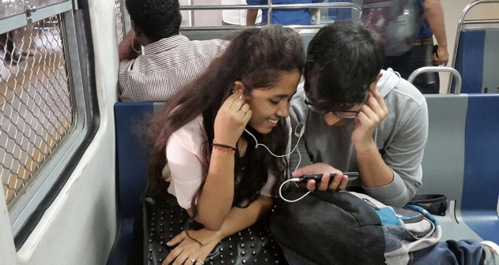

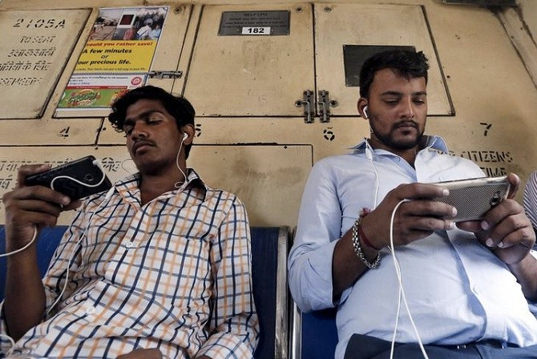
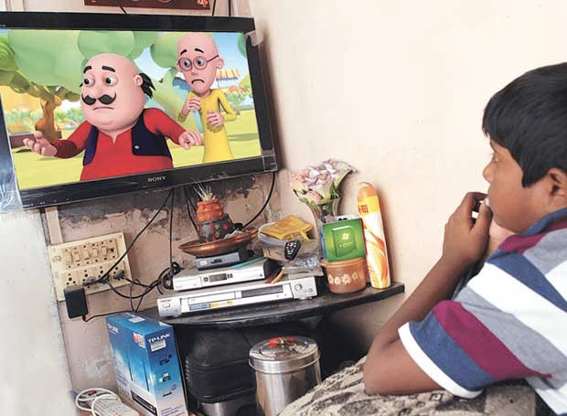
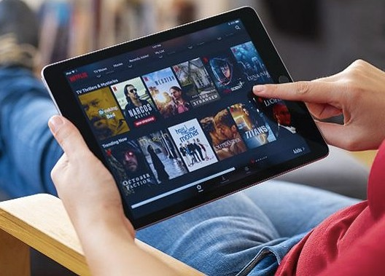

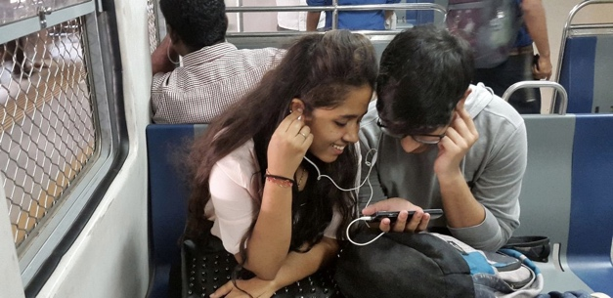
THEY ARE NOT JUST USERS, THEY ARE PEOPLE WHO SPAN
ACROSS GENERATIONS, CULTURES & SOCIO-ECONOMIC STRATAS

Slide 17


2nd largest population fastest-growing major economy maximum number of young
Notes:
India replaced France as the sixth-largest economy in the world in 2018
Although India overtook China in terms of GDP growth rate in 2014
Those under 35 represent a large proportion (65%) of the Indian population

Slide 18

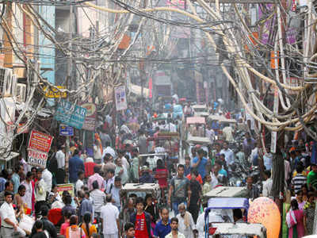


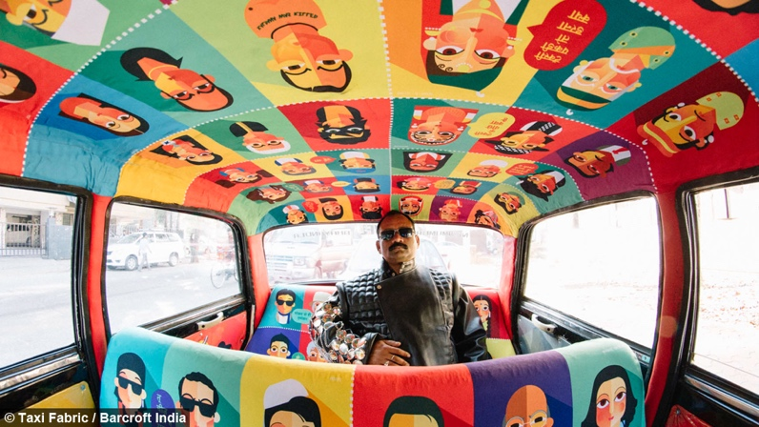
An assault on the senses

Slide 19


WE LIKE OURSELVES

Slide 20
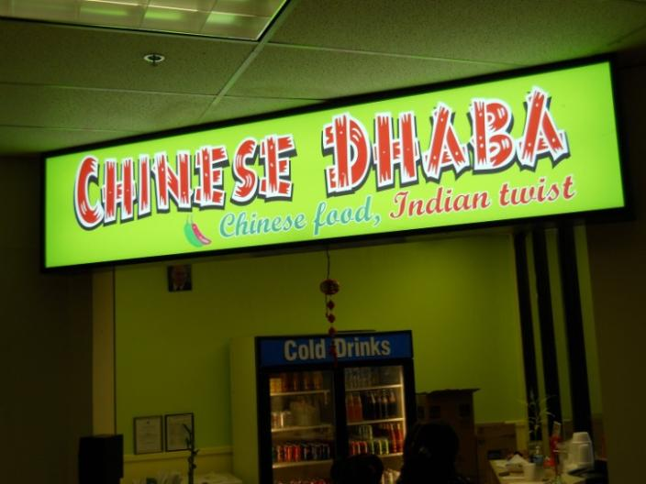
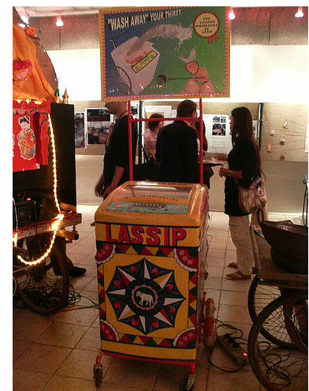
WE INDIANIZE
Kellogg’s launches a hot breakfast; Pizza hut launches a chicken tikka pizza; McDonalds becomes vegetarian

Slide 21


Slide 22


India will have 410 million millennials, who will spend $330 billion annually, that’s more than the total population of the us, and more than the total number of millennials (400 million) that china has today.

Slide 23

Global citizens
a generation of digital natives; highly individualistic, always on the go, look for convenience, passionate about health and fitness.

Slide 24

Free birds

Slide 25

Socially conscious
88% India affluent millennials prefer brands that give something back to society:
Source: BBC Advertising

Slide 26


Gemini souls
highly individualistic but also believe in the sharing economy
digital natives but they also crave real-life interaction
highly futuristic but also have a deep sense of nostalgia
Outward projection. Inside is something else (daal-chawal vs sushi)
popularised by Uber and Airbnb.

Slide 27
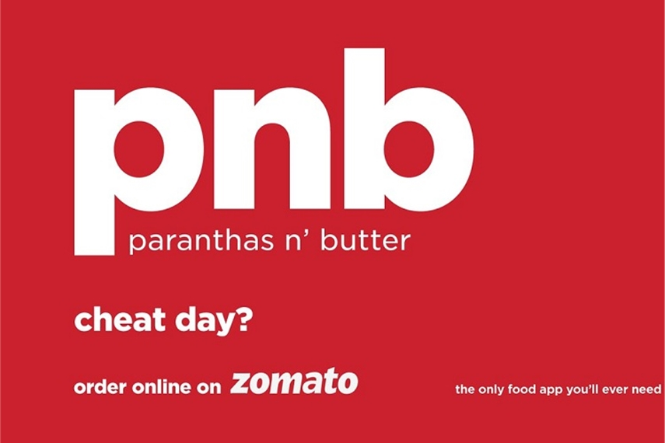


Tradition evolvers

Slide 28
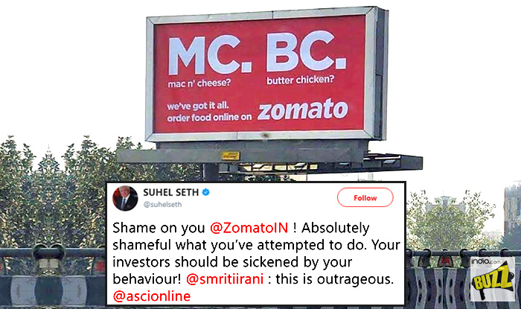
With vague limits.

Slide 29
Our core tg

Slide 30

The first mover generation
They expect the best, the latest and the most innovative experience
Primary: SEC A+, A urban, middle class M 22-45
Secondary: Female, urban, middle class, 22-45
Income level: >Rs. 60000 pm
This generation expects the best, the latest and the most innovative experience because that’s the way they lead their life.

Slide 31






Well travelled and aware. Control-seekers. Path breakers.
Notes:
A generation who is so occupied with what's in their hands that they expect their things to enable them

Slide 32
With much to do and get done, Automation adds to their life

Slide 33


Our Ambition for HOME MASTERS : belief.
Fame. Meaning. Distinction.

Slide 34
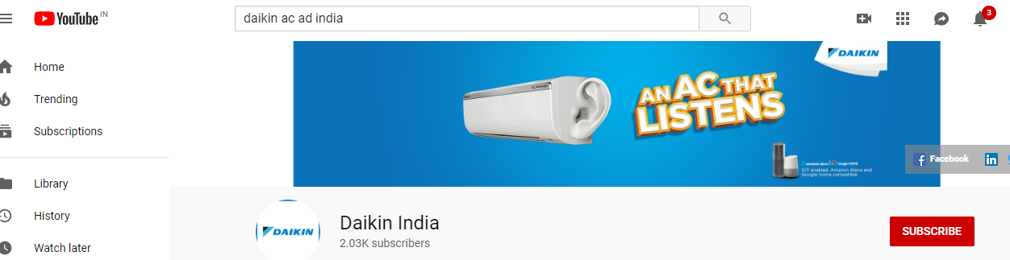
THE DISTINCTION CHALLENGE
How do we create distinction when our key competitor is offering similar benefits?

Slide 35
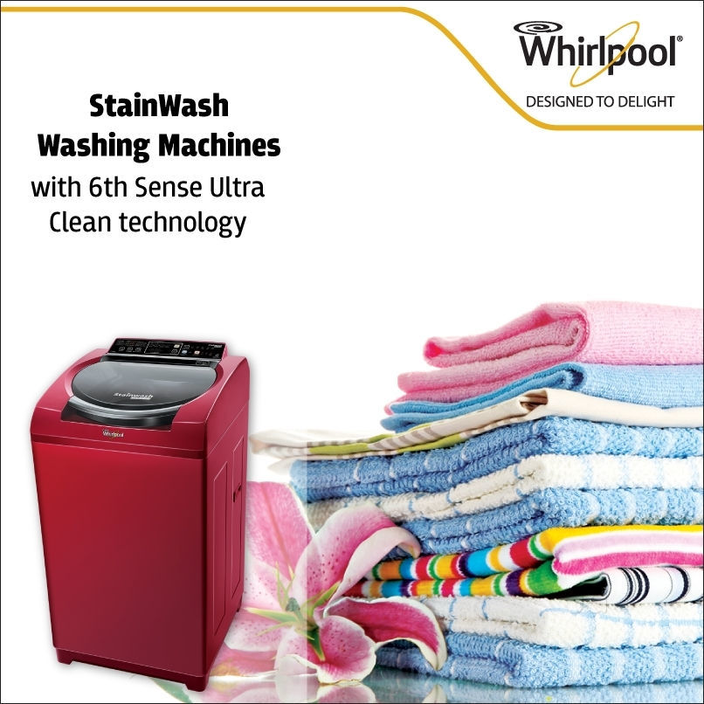
Category driven by tech memory hooks
Consumer consideration driven by a benefit that sticks in their mind.
If you’re not in the top 3 of the consideration set, chances of purchase diminish.

Slide 36

THE Home Masters Proposition
WHO
The with-it, technophile Millennial
Voice Enabled AC
WHY
WHAT
Because they have a lot to do
Voice Active Technology

Slide 37
Our strategic approach (4 P’s)

Slide 38
APPROACH
PRODUCT STRATEGY
PRICING
STRATEGY
PLACE
STRATEGY
Offering Differentiation: Highlight unique aspects such as energy efficiency, superior customer service, and quick installation times.
New Services Introduction: Consider offering air quality assessments and eco-friendly AC units as part of a broader service portfolio.
Competitive Pricing: Set prices that are competitive with local market standards while reflecting the high quality of service.
Discounts and Offers: Implement seasonal discounts and promotional offers to encourage new customer sign-ups and reward loyalty.
Local Focus: Target marketing efforts in the local area with tailored promotions designed to resonate with the local community’s needs.
Online Sales Platform: Develop a robust e-commerce platform for direct booking of maintenance services.

Slide 39
APPROACH
PROMOTION STRATEGY
DIGITAL AND SOCIAL
OOH (Out of Home Adv.)
INFLUENCER MARKETING
COMMUNITY
PR

Slide 40
The consumer journey

Slide 41





CONTEXT | Need a new a/c (replacement/ supplement) | Overwhelmed (with information and choices) | Confusion (aware of buzzwords, short-listing) | Deal hunt | Choice-made
STAGE | TRIGGER | CONSIDER | INFO SEARCH | CHOOSE | BUY
DO/THINK/FEEL | Feel anxious about an impending big purchase | Get opinions and research basis requirement (Tonnage, Variants, features Prices) | Store-checks and peer reviews to get the choice right | Visiting multiple platforms and stores Ensure no deal goes amiss | Anxiety & Anticipation
CHALLENGE | Predominance of competition | Home Masters slow on trust since it is new | Overshadowed by competition at POS | Home Masters ACs rarely included in the final comparison list | Overshadowed by competition at POS
OPPORTUNITY | Establish Panasonic’s distinctiveness & meaning | Establish expertise on the subject | Establish the Home Masters distinctiveness | Impactful deal communication | Final decision swings on key functional features
TOUCHPOINTS | Create consideration via ATL, Banners, influencers | Engagement via Banners. Microsite Tech Influencer | Drive choice at retail and in social media | Contextual Banners | Retail

Slide 42
Thank You
Slides Presented and Created by:-
Mridul Goel (2022303)
Sankalp Raj (2022445)
Sanyam Barwar (2022447)
Vivan Rangra (2022581)

